Slide 1
My-Linh Lam Weatherford’s EDU Projects
Plan to have a few projects for educational of how to build, demo or tester - devices, programming, custom circuit build and hands-on activities. These are such as Simple Electric Motor to put a Spin On It and continue running, Remote control outdoor Christmas lights using Raspberry- Pi GPIO pins with Wireless, custom circuit ,IPhone, IPad or Laptop. Also Use Raspberry-Pi GPIO pins with Scratch - programming in real time system display - Animation and LEDs circuit synch up with display . Learn components of items as needed for projects. And historical notes the first inventors found and did for life around the world. All inventors show continuing start early time through the present time based on history events.
https://github.com/mlshaunw/SDMF-Project
Sources: Internet
Prepared by My-Linh Lam Weatherford -2015

Slide 2
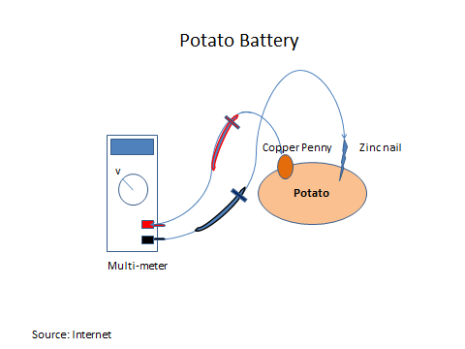
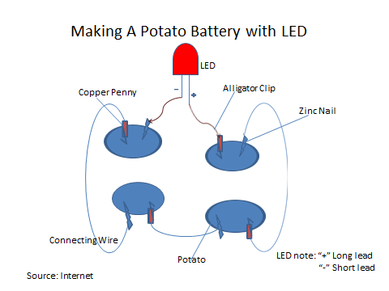
Sources: Internet
Prepared by My-Linh Lam Weatherford -2015

Slide 3
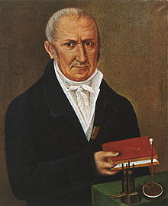
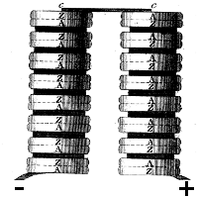
Diagram from Volta’s 1800 paper. The pile is made using discs of silver (A) and zinc (Z) linked in series with card soaked in salt water. The positive and negative polarities of this battery are as shown. Adding more pairs of discs increases the voltage of the battery.
Volta found that by connecting up more and more pairs of metals connected with moist card, he could produce ever higher voltages, leading to significant electrical currents.
Using alternating discs of zinc and copper, with pieces of cardboard soaked in brine between, which he called a Voltaic Pile, the metals produced electrical current, Alessandro Volta’s voltaic pile was the first battery that produced a reliable, steady current of electricity.
And so the electrical battery was born.
Alessandro Volta
In 1800, Volta described his results in a letter to Joseph Banks, at the Royal Society in London.
Volta’s Battery Unleashed a Wave of New Scientific Discoveries
The battery that Volta had invented gave chemists a very powerful new method to study substances.
Sources: Internet
Prepared by My-Linh Lam Weatherford -2015

Slide 4

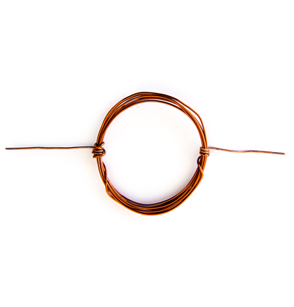
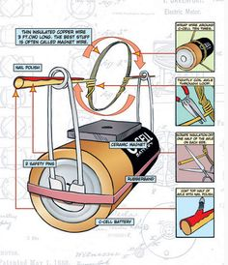
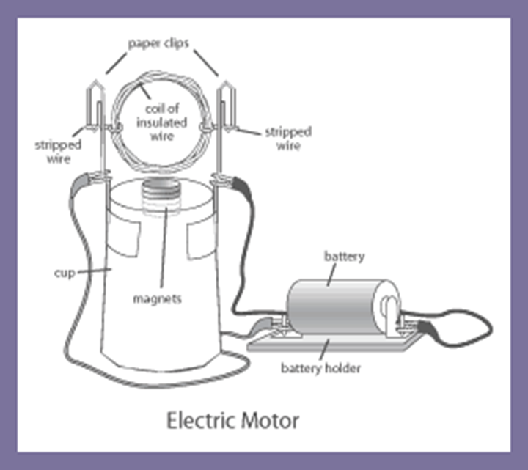
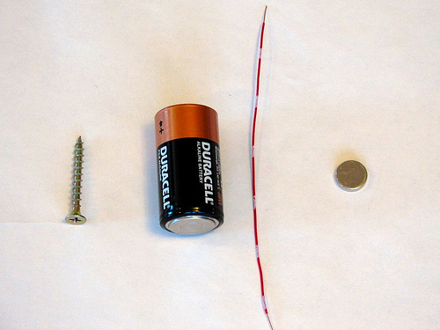
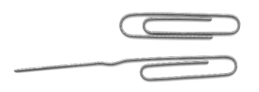
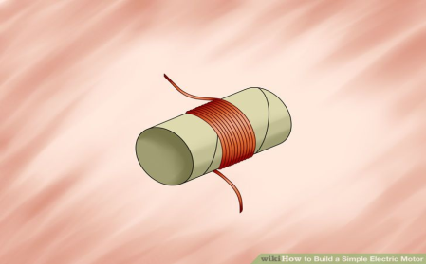
Starting in the center of the battery, take insulated wire wrap it 12 through 15 times turn around battery to form a coil. Remove insulation from the same side of each wire
Sources: Internet
Prepared by My-Linh Lam Weatherford -2015

Slide 5
Simple Electric Motor Demo
Video shows Electric Motor to put a spin on it and continue running.
The first DC electric motor capable turning machinery in 1832, his name
Is Mr. William Sturgeon.
Sources: Internet
Prepared by My-Linh Lam Weatherford -2015

Slide 6
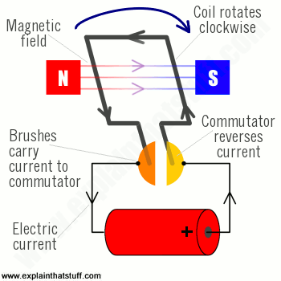
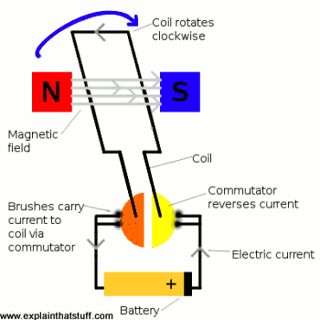
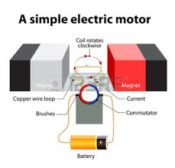
Sources: Internet
Prepared by My-Linh Lam Weatherford -2015

Slide 7
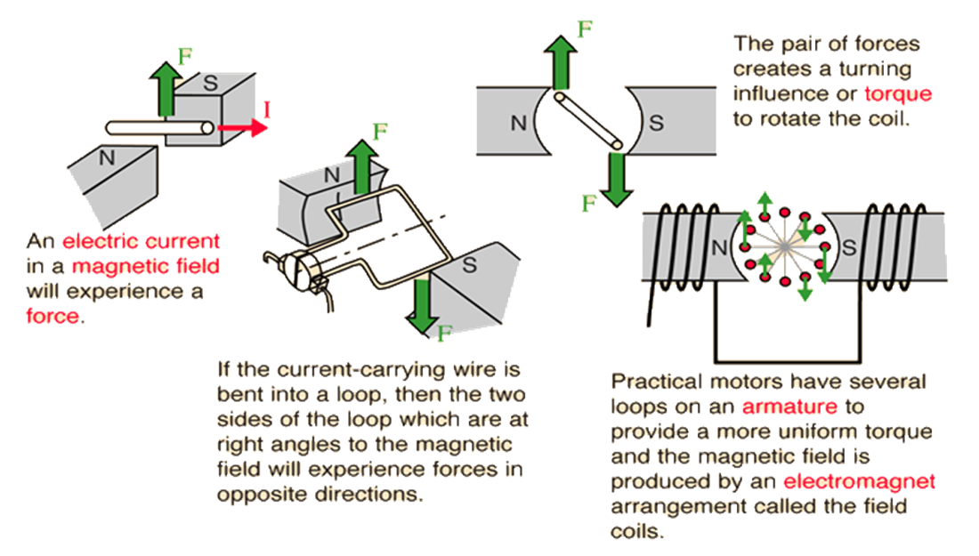
How Does an Electric Motor Works?
Sources: Internet
Prepared by My-Linh Lam Weatherford -2015

Slide 8
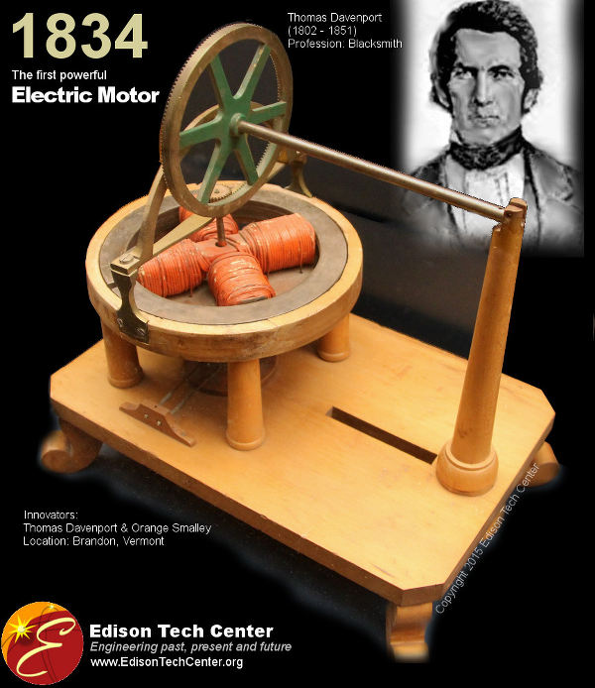
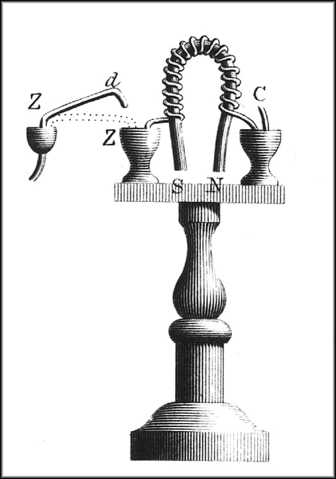
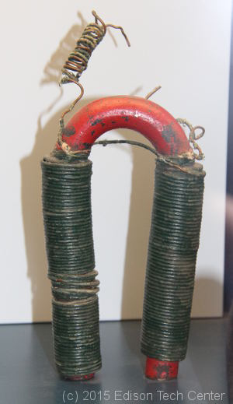
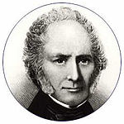
William Sturgeon
The first artificial electromagnet, invented by Sturgeon in 1824. Sturgeon`s original drawing from his 1824 paper to the British Royal Society of Arts, Manufactures, and Commerce. The magnet was made of 18 turns of bare copper wire (insulated wire had not yet been invented).
Above: one of Joseph Henry's magnets, something which inspired Davenport
Learn more about the Smalley-Davenport Shop in Brandon (Forestdale)
Following Sturgeon’s work, a commutator-type direct-current electric motor made with the intention of commercial use was build by the American inventor Thomas Davenport, which he patented in 1837. The motor ran up to 600 revolutions per minutes and powered machine tools and printing press.
Sources: Internet
Prepared by My-Linh Lam Weatherford -2015

Slide 9
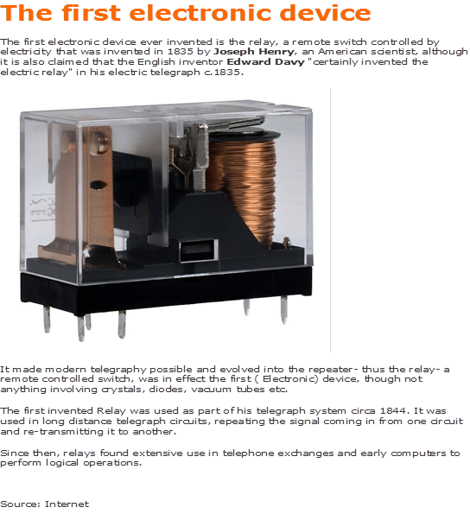

Slide 10
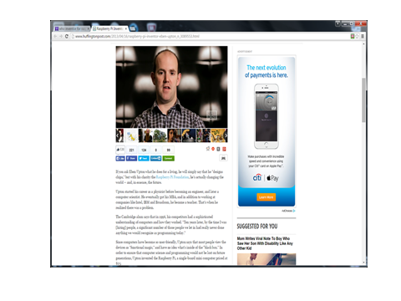

Slide 11
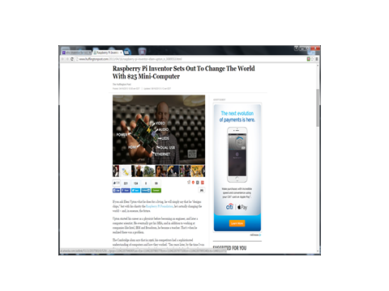

Slide 12
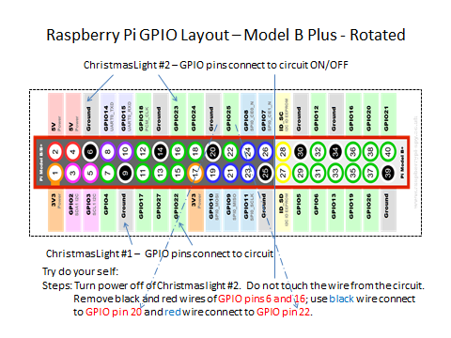

Slide 13
